Slide 1



Welcome to
CS 345 Operating Systems
Memory Management, Ch 7 (18)

Slide 2
Tip #19: Before C Starts…
What happens when your computer boots up?
Execution starts at the reset vector.
Assembler code configures and initializes the CPU core, putting it into a clean state to avoid Lock Step exceptions when saving state later.
MMU configured for RAM access, rest of the flash, and on-chip peripherals. Reconfiguring the TLB entries describing flash often requires to code to be copied to and executed from RAM.
Watchdog configured to prevent timeout during initialization.
ECC RAM and caches initialized.
Variables initialized for C by copying the init values from flash to RAM.
If RAM code is needed (e.g. for flash programming functions), after copying the data cache has to be cleaned, write buffer synchronized and instruction cache invalidated, to force it re-reading the updated code.
Call stack, C stack, small data pointer etc… have to be set up.
Then finally main() can be called.
In main(), initialization continues…
Setup interrupts and exception handling mechanisms.
Self Test Control Unit, Fault Collection and Control Unit initialized.
CPU run modes initialized, peripheral clocks enabled, and configured.
PLL set up, timing adjusted for the high clock.
Then all peripherals and subsystems have to be initialized.
…

Slide 3
Paging
How is a program started?
Start a process with no pages in memory (pure demand paging).
Place in memory on a page fault.
At what point in a program’s execution can a page fault occur?
instruction fetch
operand fetch
operand store (any memory reference)
What is the worse case of page faulting?
VLIW or CISC instruction: Add C,A,B (C = A + B)
Instruction and all operands on different pages
4 possible page faults )-: slooooow :-(
Notes:
Adobe Photoshop does its own virtual memory
Crossing a page boundary (instruction not in memory)

Slide 4
Simple Paging
Use page number as an index into the page table, which then contains the physical frame holding that page.
Typical Flag bits: Present, Accessed, Modified, various protection-related bits.
Logical Address
Page # | Offset
Main Memory
Frane # | Flags
+
Frame # | Offset
Physical Address
Page Table Ptr

Slide 5
Paging Hardware
How large are page tables?
4G address space with 4K pages requires 4M entries (2³² / 2¹² = 2²²)
8 byte page table entry  4M entries = 32M memory
Solutions?
Put page tables in VM space.
Most systems use multilevel page tables
Top level page table validates entire address space.
Second level page table only used if that part for part of address space.
Second level tables can also be used for shared libraries.

Slide 6
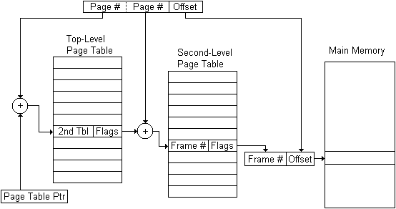
Multi-level Simple Paging
Use page number as an index into the page table, which then contains the physical frame holding that page
Logical Address
Physical Address

Slide 7
Simple Paging Exercise
Consider a simple (1 level) byte addressable paging system with the following parameters: 2²⁴ bytes of physical memory; page/frame size of 2¹¹ bytes; 2⁹ pages of logical address space.
page table
logical address
physical address
...
How many bits are in a logical address?
How many bytes in a frame?
How many bits in the physical address specify the frame #?
What is the size of the logical address space?
How many bits in each page table entry? (Include valid, dirty, and pin bits.)
f. What is the size of a page table?

Slide 8
Simple Paging Exercise
Consider a simple (1 level) byte addressable paging system with the following parameters: 2²⁴ bytes of physical memory; page/frame size of 2¹¹ bytes; 2⁹ pages of logical address space.
page table
logical address
physical address
...
9 bits | 11 bits
vdp| 13 bits
13 bits | 11 bits
2⁹ pages + 2¹¹ bytes/page = 20 bits
How many bits are in a logical address?
How many bytes in a frame?
How many bits in the physical address specify the frame #?
What is the size of the logical address space?
How many bits in each page table entry? (Include valid, dirty, and pin bits.)
f. What is the size of a page table?
2¹¹ = 2048 bytes
24 - 11 = 13 bits
2⁹⁺¹¹ = 1,048,576 bytes
24 - 11 + 3 = 16 bits
2⁹ × 2 = 1024 bytes

Slide 9

Memory References
Check TLB for resolved address. If found, append offset and return physical address.
If TLB miss, index into page table. If hit, append offset and return physical address.
If page table miss (page fault), either find free frame or unload a frame, read referenced page into frame (if in secondary memory), update page table and TLB, append offset and return physical address.
Notes:
Page fault is an interrupt
OS only one to go get a faulted page

Slide 10
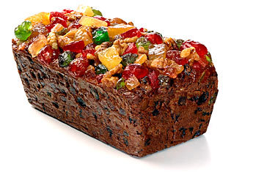
Segmentation
Fault
3a. Page Hit
M
M-1
M-2
…
0
1
2
Main
Memory
3b. Invalid Page Request
Page Table
2a. TLB Hit
5. Page Table Update
R/W Data
3a. TLB Update
2b. TLB Miss
3c. Page Fault
4. Page Swap
CPU
1. Virtual Address
TLB
12345678
Secondary
Storage
MMU

Slide 11
Replacement Algorithms
Random (RAND)
choose any page to replace at random
Belady’s Optimal Algorithm
best but unrealizable – used for comparison
First-In, First-Out (FIFO)
for the dogs, forget ‘em
Least Frequently Used (LFU)
strictly a straw-man for stack algorithms
Least Recently Used (LRU)
discard pages we have probably lost interest in
Clock – Not Recently Used (NRU)
efficient software LRU

Slide 12
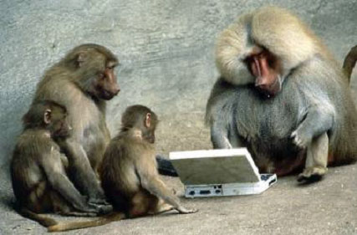

Be Safe

